Slide 1

HOSPITALITY DATA ANALYSIS

Slide 2

AGENDA
GROUP-5 TEAM MEMBERS :
JAINI SAI HARSHINI
KALUVA RAHUL
ATHARV NILKANTH BUDHE
ABHISHEK DEB
DARSHAN P HIDAKAL
AKHIL SABU ABRAHAM
PRAVEEN SOBANAD

Slide 3
AGENDA
SUMMARY
KPI LIST
EXCEL
TABLEAU
POWER BI
SQL
KEY TAKE AWAY

Slide 4

SUMMARY
By leveraging the insights derived from the dataset and dashboard, stakeholders can significantly elevate operational efficiency, optimize quality control protocols, reduce costs, and empower informed decision-making to propel manufacturing excellence.
Benefits: This approach facilitates comprehensive performance monitoring, enabling the swift identification of issues and fostering a culture of data-driven decision-making. As a result, organizations can enhance productivity, streamline processes, and achieve strategic objectives with precision.

Slide 5
SUMMARY
DASHBOARD OVER-VIEW:
Purpose: Delivers a holistic overview of service and operational metrics in hospitality management.
Key Features: Monitors service data to enhance guest satisfaction and operational efficiency. Provides actionable insights for evaluating performance and facilitating data-driven decision-making.
Includes: Visual representations for improved comprehension. Analysis on guest feedback, occupancy trends, revenue streams, and more.

Slide 6

Kpi- list
Total Revenue: The dashboard indicates a total revenue of 2,007.5M, allowing management to see the overall financial health. Occupancy Rate: At 58%, this metric reflects how well rooms are being utilized across the properties. Total Bookings and Cancellation Rate: With 134,590 total bookings and a 25% cancellation rate, this allows stakeholders to assess customer behaviour and focus on reducing cancellations, perhaps through better customer engagement. Booking Status: The bookings into statuses such as “Cancelled,” “Checked Out,” and “No Show,” giving a quick snapshot of how many bookings convert into actual stays. | Revenue by Class and Platform: This section shows how different booking platforms (like journey or laptop) and room classes (like Elite, Premium, etc.) contribute to overall revenue. City-Based Analysis: The revenue by city (e.g., Bangalore, Mumbai, Hyderabad), providing a geographic breakdown that can guide decisions about resource allocation and market focus. Weekly Trends: The weekly trend analysis for total bookings and occupancy helps management understand fluctuations over time and adjust pricing, promotions, or staffing to better manage demand.

Slide 7

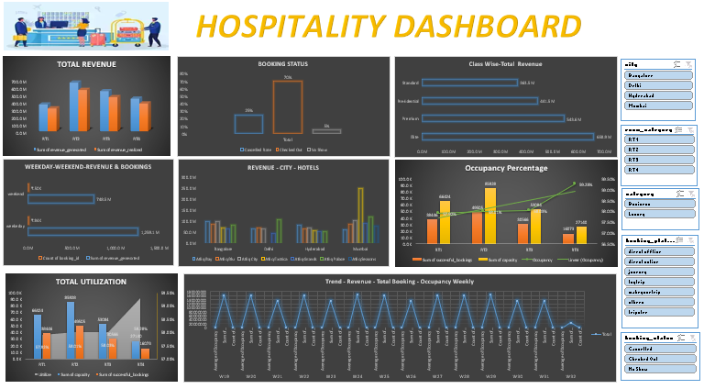
Excel dashboard

Slide 8
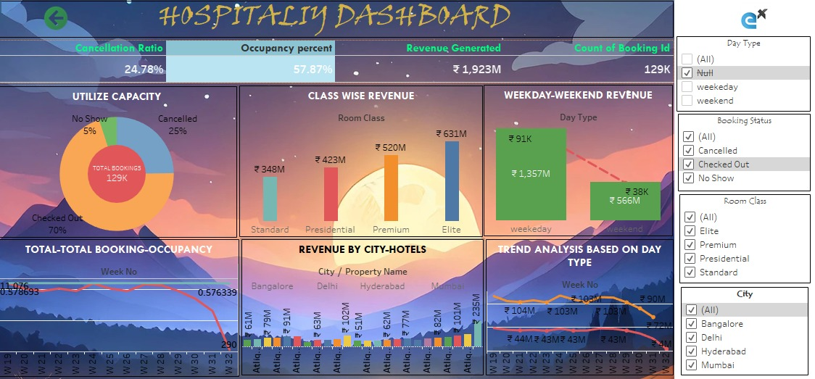
tableau dashboard

Slide 9
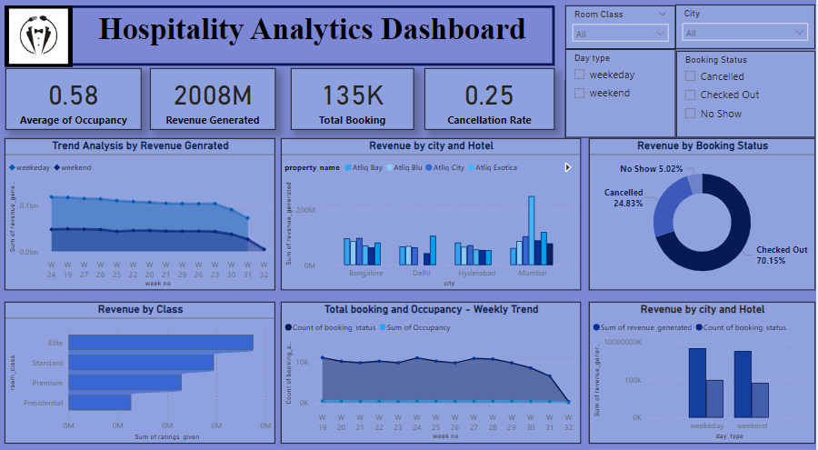
Power bi dashboard

Slide 10








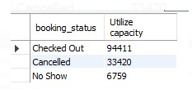
My SQL syntax

Slide 11
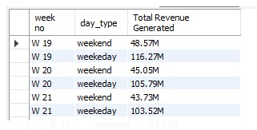
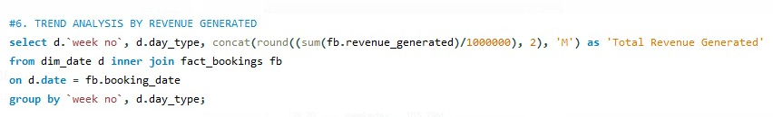
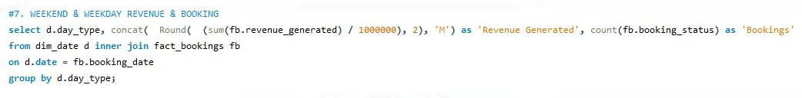
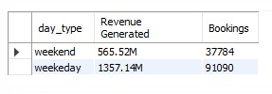
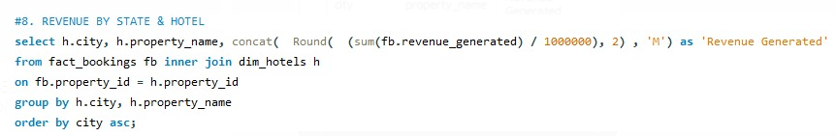
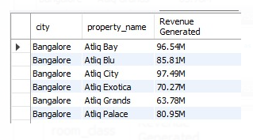
My SQL syntax

Slide 12
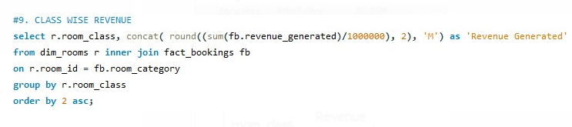
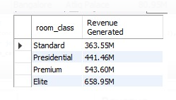
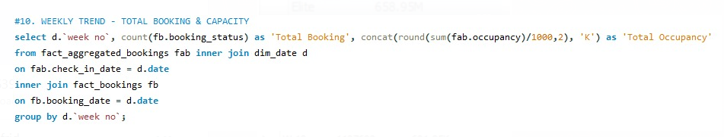
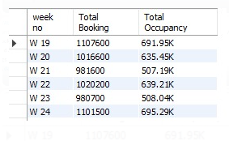
My SQL syntax

Slide 13
KEY TAKE AWAYS
Service Metrics Tracking: The dataset captures essential service metrics such as Guest Satisfaction Scores, Reservation Rates, Occupancy Levels, and Cancellation Rates, providing a comprehensive overview of hospitality operations.
Quality Control Insights: Monitoring feedback and complaint rates, both by staff and service area, offers valuable insights into service quality, enabling proactive measures to address issues and enhance quality assurance practices.
Operational Efficiency: Analysing service comparison trends and department-wise occupancy versus complaint rates helps identify operational inefficiencies, allowing for targeted optimization of processes and resource allocation.
Data-Driven Decision Making: The dataset empowers stakeholders to make informed decisions by providing accurate and timely data through analytics tools, enabling strategic planning and service enhancements.
Performance Monitoring: Through the dashboard, stakeholders can track daily, weekly, and monthly service metrics to monitor performance, set targets, and drive continuous improvement in hospitality services.
Cost Optimization: By reducing cancellations and improving service quality, the dataset reveals opportunities for cost savings and resource optimization, contributing to overall operational efficiency and financial sustainability.
Enhanced Quality Control: Focusing on service feedback and complaint rates enables a more detailed approach to quality control, leading to improved service delivery and increased guest satisfaction.
The hospitality dataset and dashboard offer a wealth of information critical for optimizing service processes, enhancing quality control, and facilitating data-driven decision-making to drive efficiency and success in hospitality management.

Slide 14

THANK YOU

